Slide 1

Voice-based gender identification

Slide 2


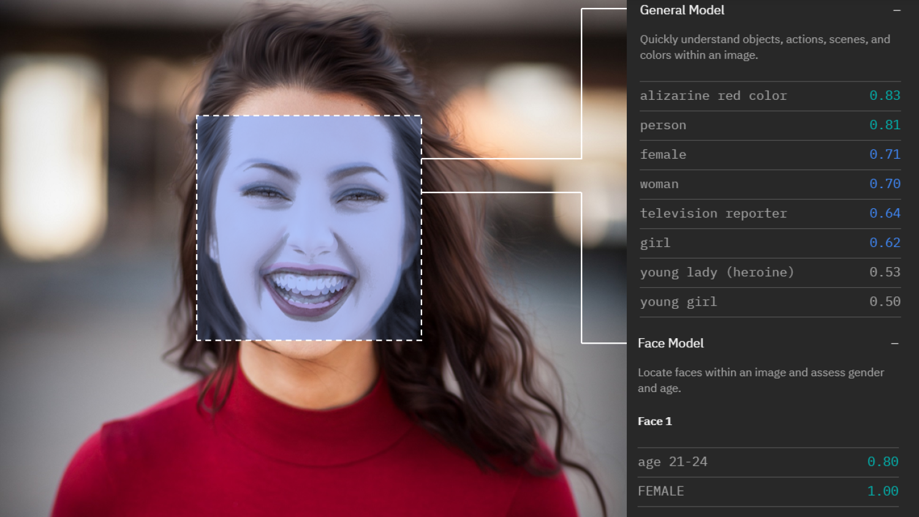

Abstract
Voice-based gender identification
Determine gender based on photos
Rendering images from 2D to 3D
voice recognition is a recognition system that uses Use frequencies and Acoustic Properties Measured to determine whether the person is male or female. In this project we used ML algorithms including Logistic Regression, GaussianNB, Decision Tree, Random Forest, and achieved 98.78% accuracy on the dataset

Slide 3
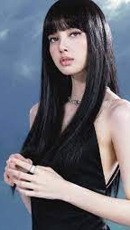
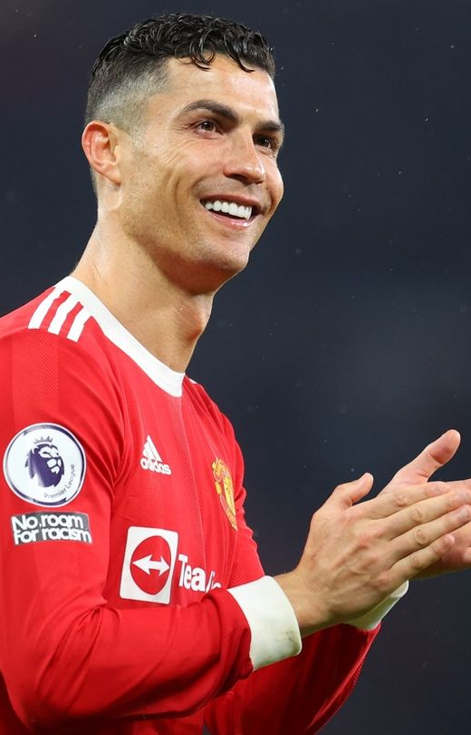
INTRODUCTION
?

Slide 4
INTRODUCTION
The model is constructed using 3,168 recorded samples of male and female voices, speech, and utterances. The samples are processed using acoustic analysis

Slide 5

PROJECT GOAL

Slide 6

DATA
We won't be using raw audio data since audio samples can be of any length and can be problematic in terms of noise.
We'll be using Mozilla's Common Voice Dataset, a corpus of speech data read by users on the Common Voice website. Its purpose is to enable the training and testing of automatic speech recognition.

Slide 7
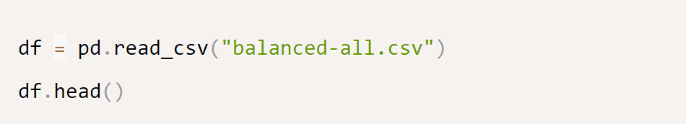
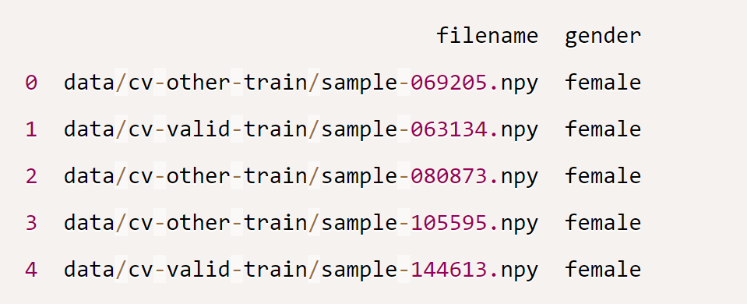
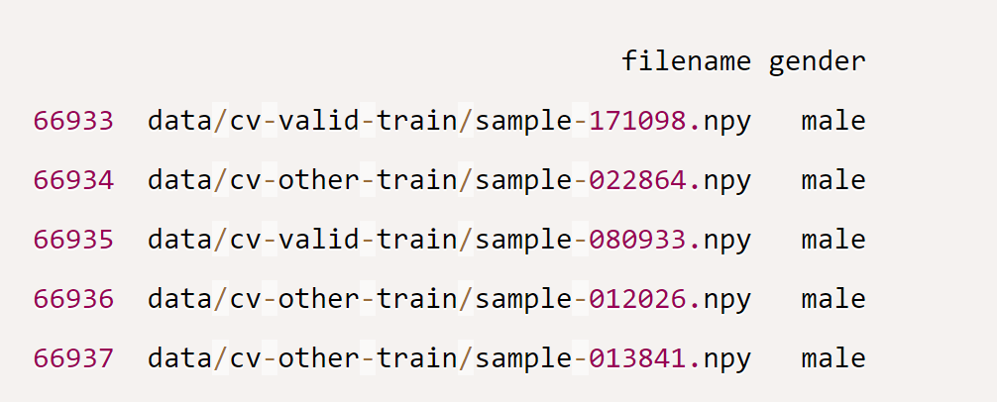
DATA
Input File:
Output:

Slide 8
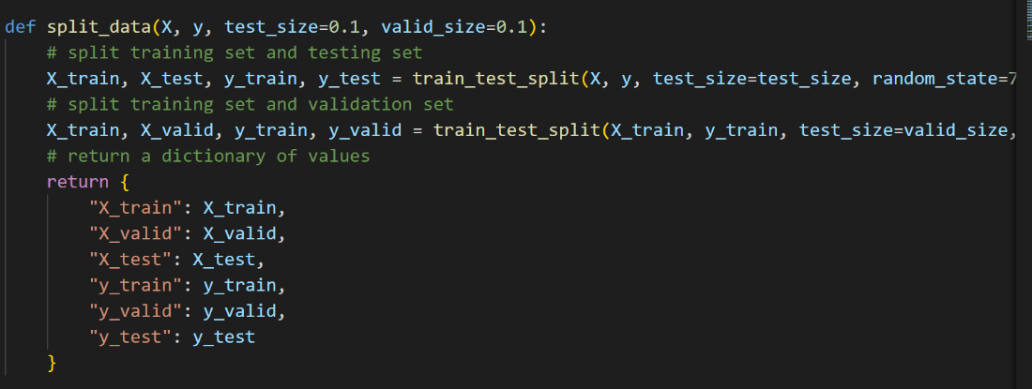
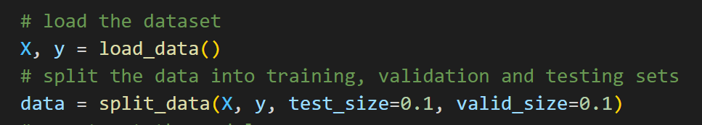
DATA
Split our dataset into training, testing, and validation sets:
Using sklearn's train_test_split() convenient function, which will shuffle our dataset and split it into training and testing sets. Then rerun it on the training set to get the validation set

Slide 9

System Design & Implementation

Slide 10
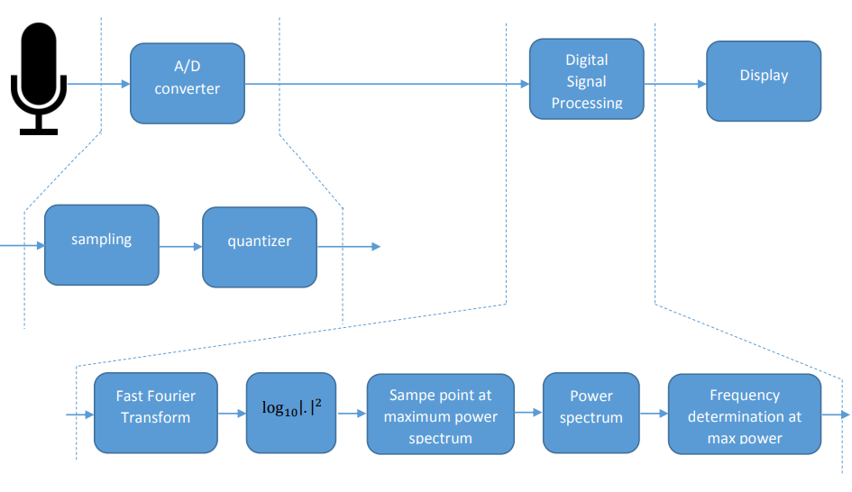
System Design & Implementation

Slide 11
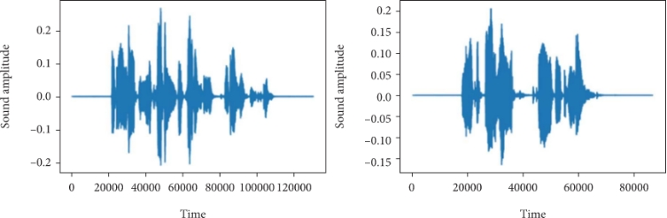
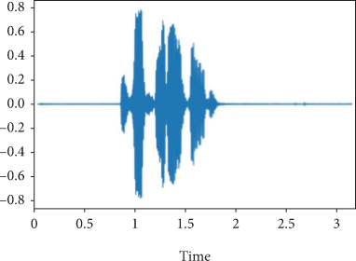
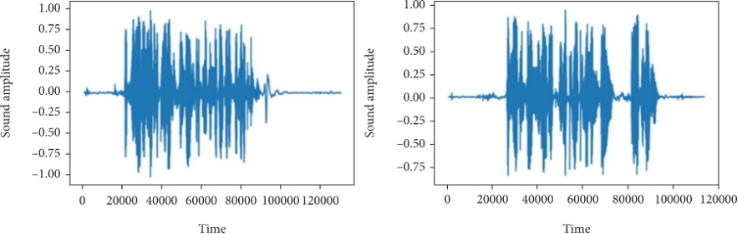
System Design & Implementation
Waveform for the Female voice
Original time domain signal
Waveform for the male voice

Slide 12

Method
Fourier Transforms
Discrete Fourier Transform (DFT)
Fast Fourier Transform (FFT)
Chroma-STFT (Short-Time Fourier Transform)
Mel Spectrogram

Slide 13

Fourier Transforms
$$\hat{f}\left(ε\right)= \int_{−∞}^{+∞}{f\left(x\right)e^{−i2πεx}dx, ∀ε∈R}$$
First, it is decomposed into building components that can be processed more efficiently for better signal understanding. When these building blocks are exponential functions, the process is called Fourier analysis.
Fourier transform integral
f$\left(x\right)= \int_{−∞}^{+∞}{\hat{f}\left(ε\right)e^{−i2πεx}dε, ∀ε∈R}$
Fourier inversion integral

Slide 14


Discrete Fourier Transform (DFT)
$$X_{k}= \sum_{n=0}^{N−1}{x_{n}e^{−\frac{2πi}{N}kn} ∀k=0,,,,,N−1}$$
The discrete Fourier transform is called the finite Fourier transform and transform in Fourier analysis for discrete time signals.
The input for this transformation is a finite series of real or complex numbers.
DFT's formula
$$x_{k}= \frac{1}{N}\sum_{n=0}^{N−1}{X_{k}e^{\frac{2πi}{N}kn} ∀k=0,,,,,N−1}$$
IDFT's formula

Slide 15
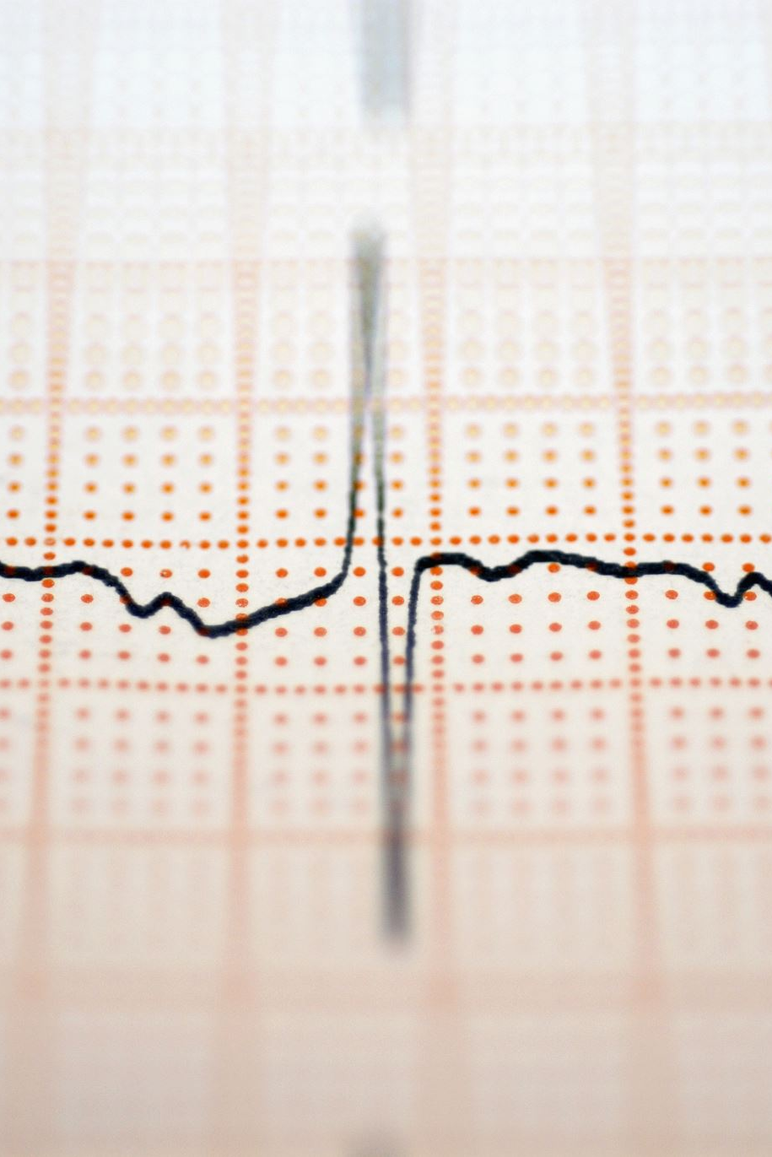

Fast Fourier Transform (FFT)
$X_{k}= \sum_{n=0}^{N−1}{x_{n}e^{\left(−\frac{j2πkn}{N}\right)}k ∀k=0,1,2,..,N−1}$

Slide 16
Chroma-STFT (Short-Time Fourier Transform)
The STFT represents information about pitch classification and signal structure:
An octave is defined as the distance of 12 pitches in our scale
An octave is an interval or interval in time between a musical note and another note of half or twice its frequency.
Tone Pitch and Tint are two components of pitch.
The pitch is the number of octaves and Chroma is the pitch.

Slide 17
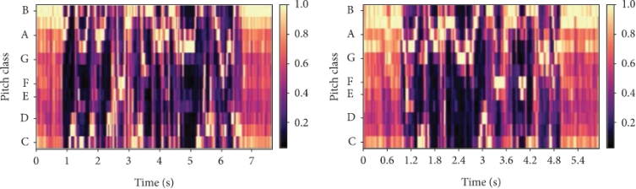
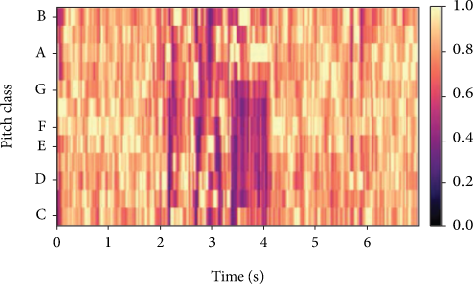
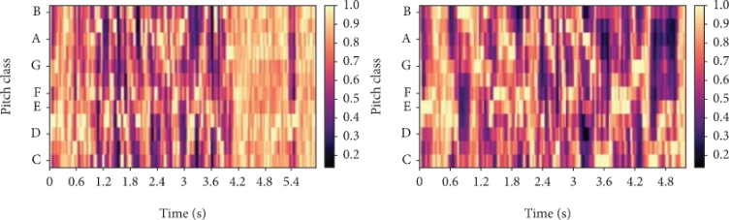
Chroma-STFT (Short-Time Fourier Transform)
Chromogram for the Female voice
Chromogram
Chromogram for the Male voice

Slide 18
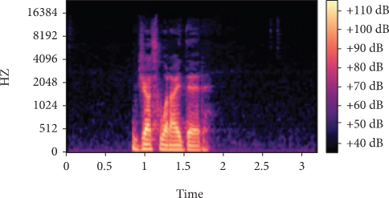
Mel Spectrogram
Spectrum is an image that represents the frequency spectrum of a signal.
The Mel scale [3] is a mathematical representation of how the human ear works
In mathematical terms, the Mel scale is the result of a nonlinear transformation of
frequency scale

Slide 19
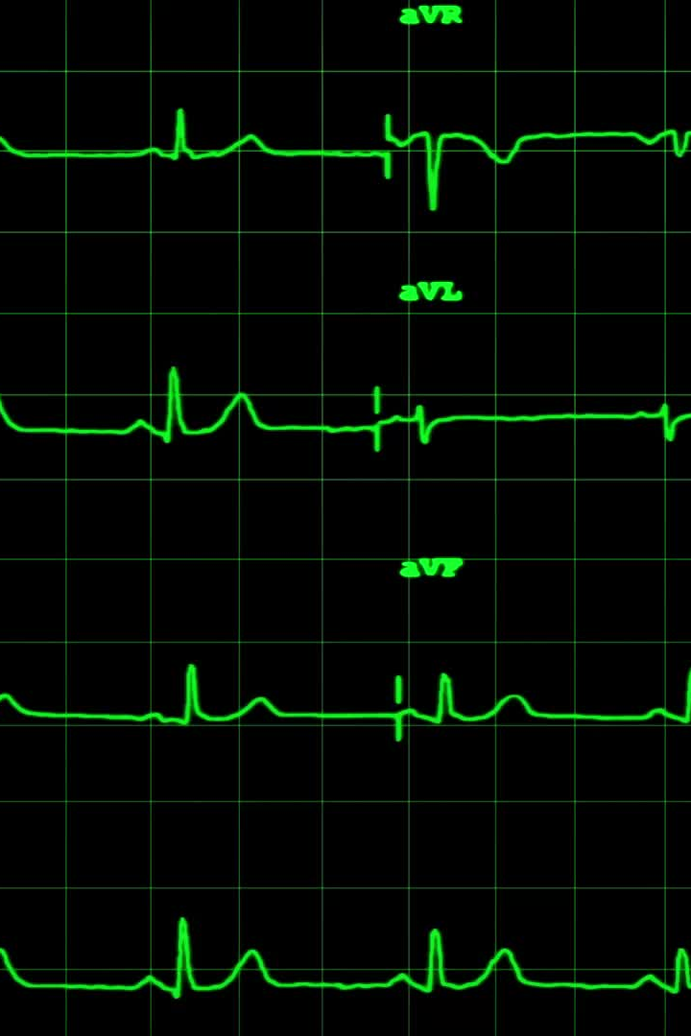
MFCC
MFCC Accurately Depicts The Vocal, Filtered Shape Of The Human Voice And A Short-time Power Spectral Envelope.
The First 13 Coefficients Of The Mfcc Are Considered Features Because They Reflect The Spectral Envelope
The Higher Dimensions Have Been Removed Showing Subtleties Of The Spectrum

Slide 20
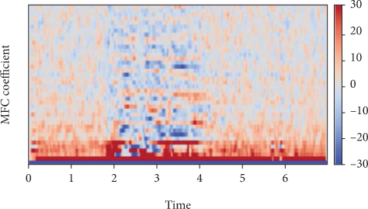
MFCC
MFC coefficients

Slide 21
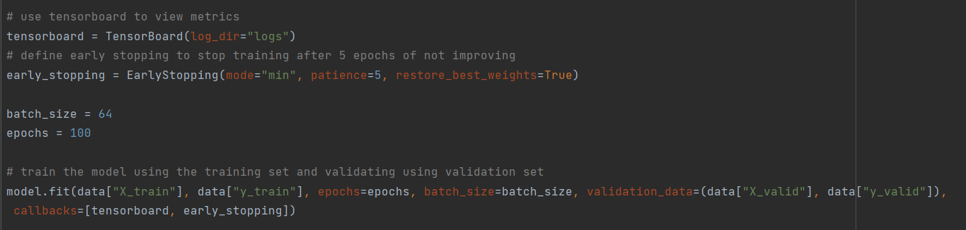
Progress
Training the model
The first is the tensorboard; we will use it to see how the model goes during the training in terms of loss and accuracy.
The second callback is early stopping; this will stop the training when the model stops improving

Slide 22
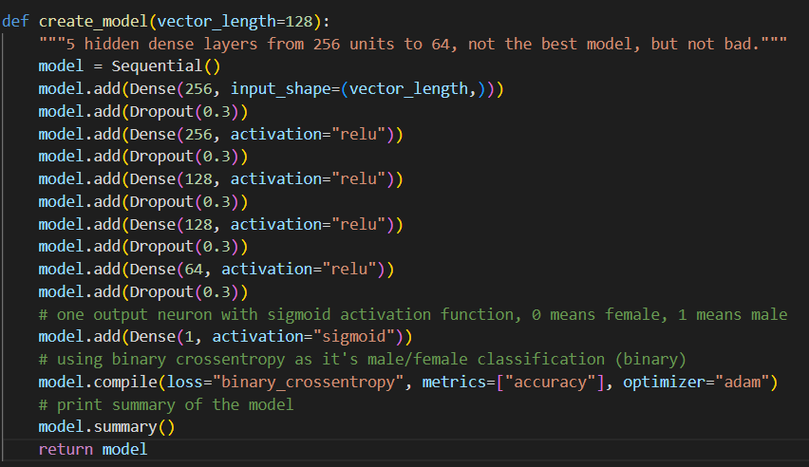
Building the model
We Use a deep feed-forward neural network with 5 hidden layers. We use a 30% dropout rate after each fully connected layer; this type of regularization will hopefully prevent overfitting on the training dataset

Slide 23
Test the model
First thing we will use PyAudio to use for our voice input.
Second, we will record the input voice into a file using the record_to_file command.
Next we will have a function that will be responsible for loading the audio file and extracting features from it. Finally, we will predict

Slide 24
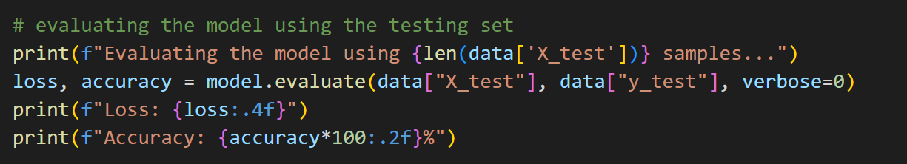
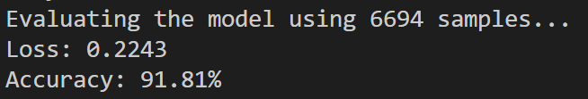
Results and Discussion
Output:
We've reached nearly 92% accuracy on samples at this time.

Slide 25
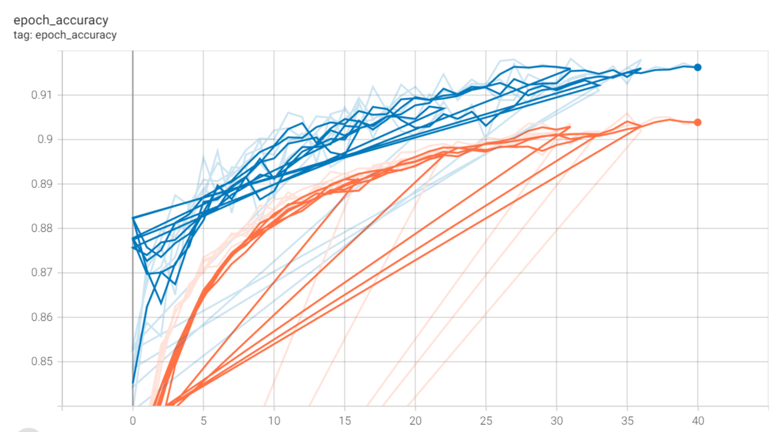
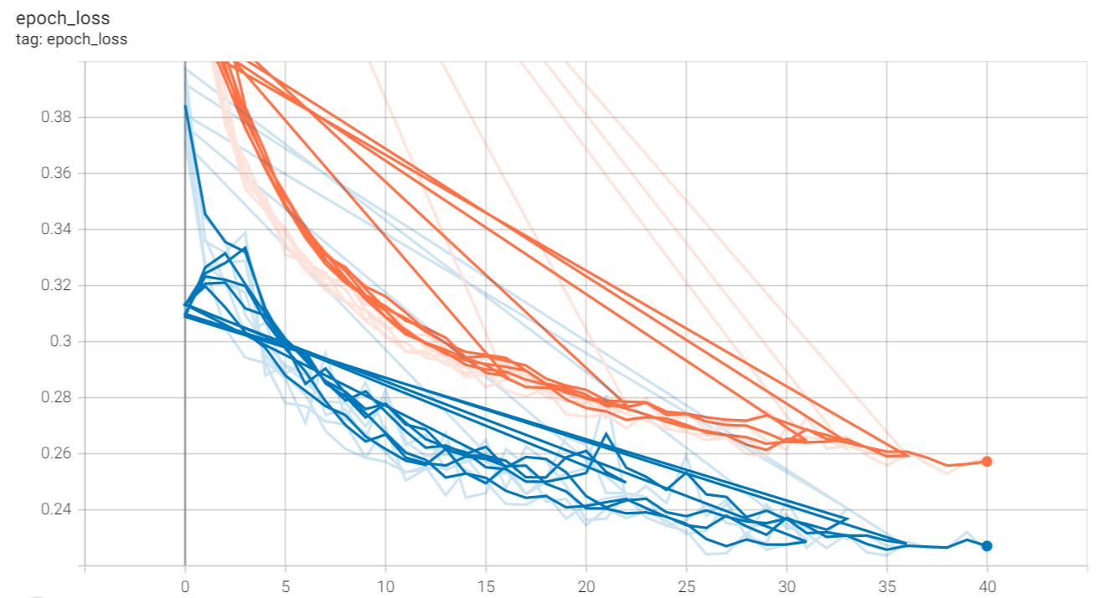
Accuracy score chart
Loss score chart

Slide 26
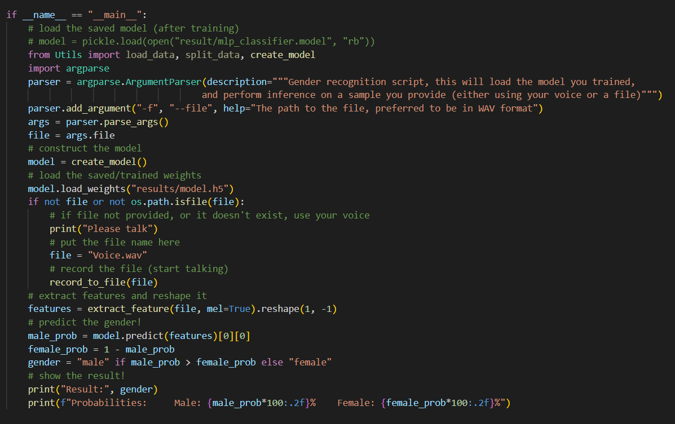
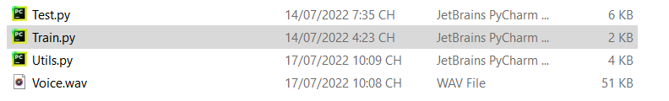
Testing the Model with my Voice
Output:

Slide 27

Conclusion and Perspectives

Slide 28
References
D. Gabor, “Theory of communication. Part 1: the analysis of information,” The journal of the Institution of Electrical Engineers. Radio and communication engineering, vol. 93, no. 26, pp. 429–441, 1946.View at: Publisher Site | Google Scholar
K.-I. Kanatani, Group-Theoretical Methods in Image Understanding, Springer Science & Business Media, vol. 20, 2012.
S. S. Stevens and J. Volkmann, “The relation of pitch to frequency: a revised scale,” The American Journal of Psychology, vol. 53, no. 3, pp. 329–353, 1940.View at: Publisher Site | Google Scholar
T. Qiao, S. Zhang, Z. Zhang, S. Cao, and S. Xu, “Sub-spectrogram segmentation for environmental sound classification via convolutional recurrent neural network and score level fusion,” in 2019 IEEE International Workshop on Signal Processing Systems (SiPS), pp. 318–323, Nanjing, China, 2019.View at: Publisher Site | Google Scholar
1
2
3
4

Slide 29
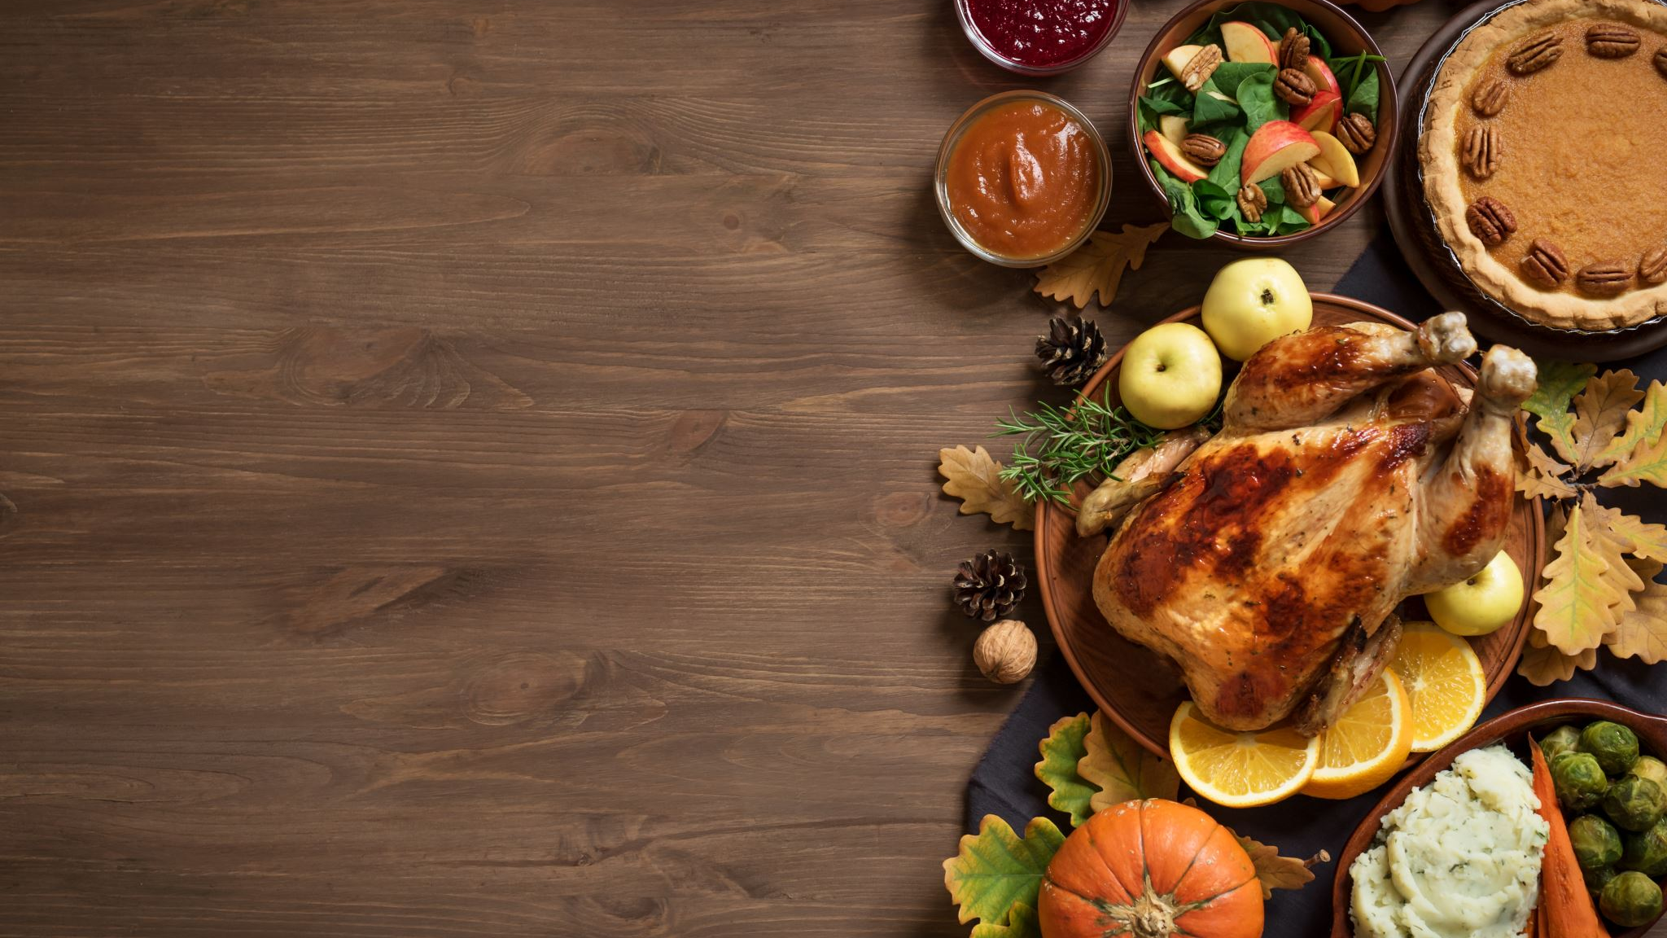
Thanks for watching

